Slide 1

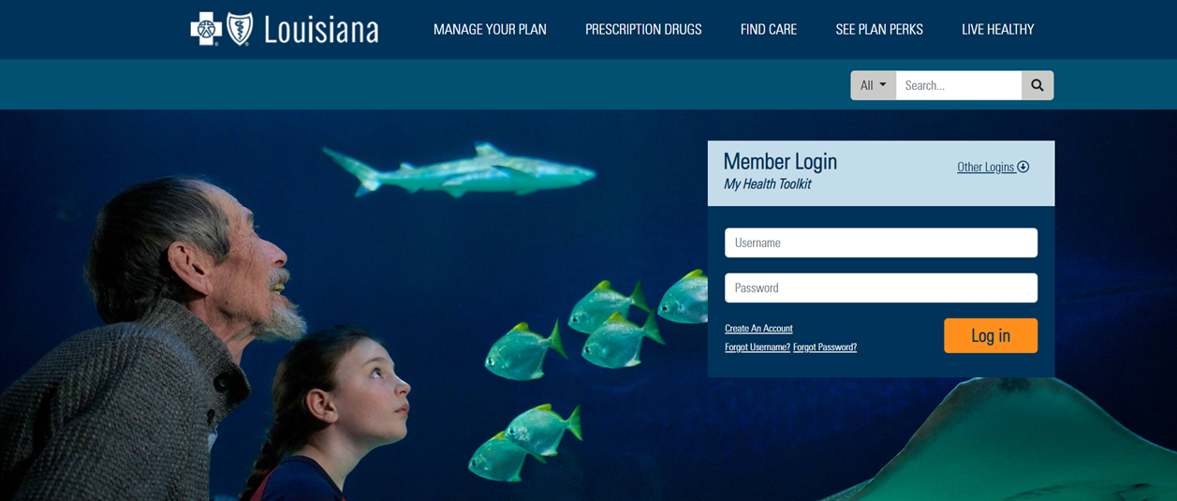

BSBS “Find Care” Provider Search Tool
Step-By-Step Guide
www.MyHealthToolkitLA.com/links/fmolhs

Slide 2
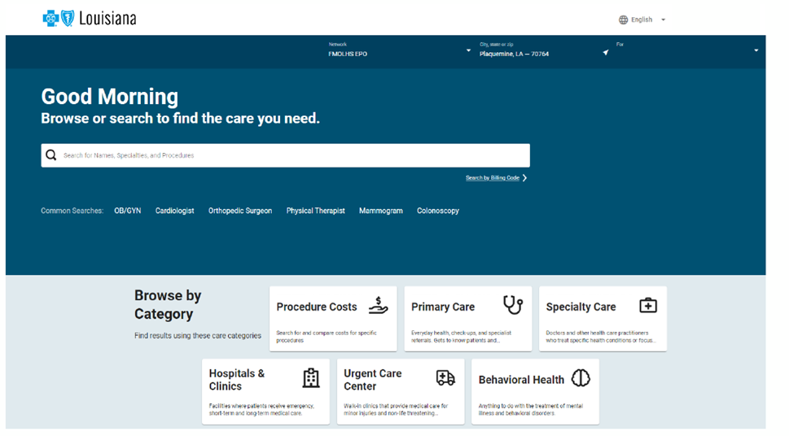
About the Find Care Tool
BCBS transitioned to a new provider search tool that allows subscribers to not only search for providers but also shop for care based on prices.
To find the current list of FMOLHS customized EPO narrow network or PPO FMOLHS network (Tier 1) and Preferred Provider network (Tier 2) online, visit MyHealthToolkitLA.com/links/fmolhs or download the My Health Toolkit Mobile App.* *For instructions on how to download the app, reference slide 12.
When Using the Cost Tool, keep in mind:
The cost tool is based on claims data and because of this the actual provider group names or facility names may not appear. This is due to the way providers file claims after reading tests. For example:
If you search for ABC Radiology Group, the name may not come up if there are not enough claims filed under the provider.
If Dr. Brown works for ABC Radiology Group and you search for his name, it will likely show more results due to the way claims are filed.
If you do not have access to the website, please call Blue Cross Blue Shield Customer Service at 833-468-3594 for assistance.
MyHealthToolkitLA.com/links/fmolhs

Slide 3
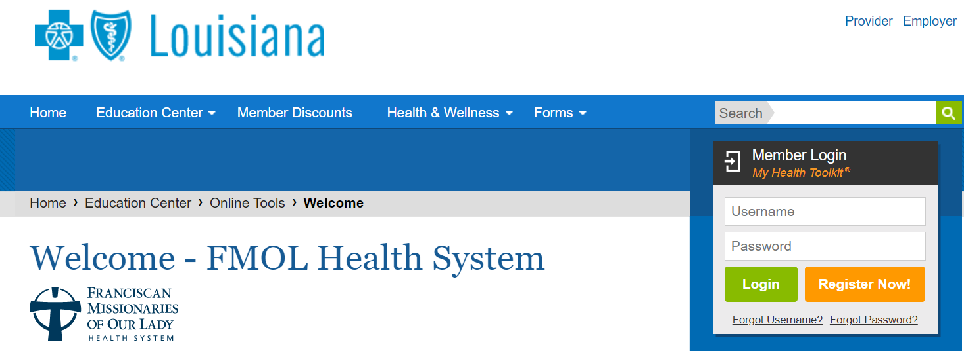

How to Access the Find Care Tool
1. Visit MyHealthToolkitLA.com/links/fmolhs
2. Log into My Health Toolkit by entering your username and password.
If this is your first visit to the site, click Register Now!
3. Select Resources from the top banner.
4. Then select Find Care.
MyHealthToolkitLA.com/links/fmolhs

Slide 4
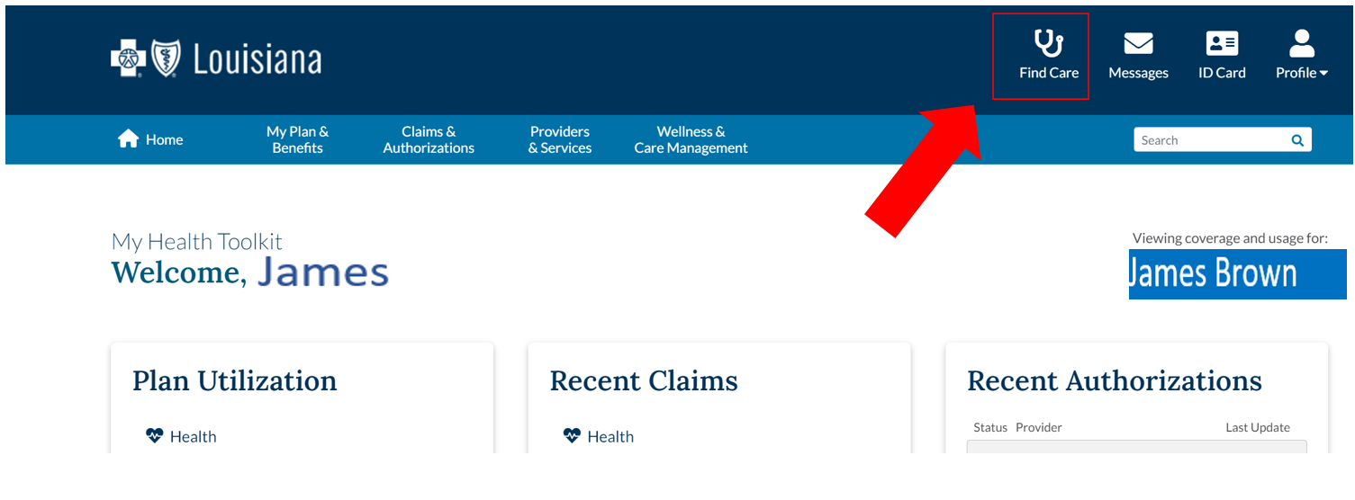
How to Access the Find Care Tool
With the new Find Care tool, you can check the cost of a visit or procedure based upon your specific plan. In addition, you will know your cost based upon your own plan’s deductible, copay and coinsurance requirements per year.
Resources > Find Care > Shop for Care
myhealthtoolkitla.com/links/fmolhs

Slide 5
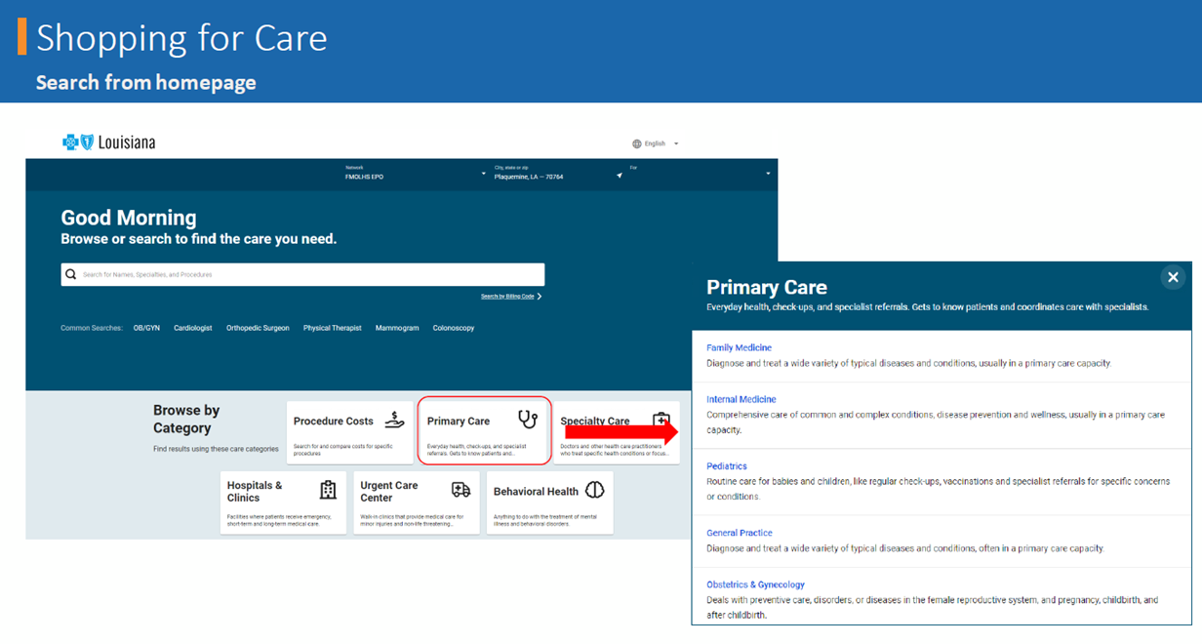
Searching for a Provider
With the new Find Care tool, you can also find in-network primary care and specialty providers in your specific plan. In addition, you will know your cost based upon your own plan’s deductible, copay and coinsurance requirements per year.
Primary or Specialty Care > Select the Care Need.
myhealthtoolkitla.com/links/fmolhs

Slide 6
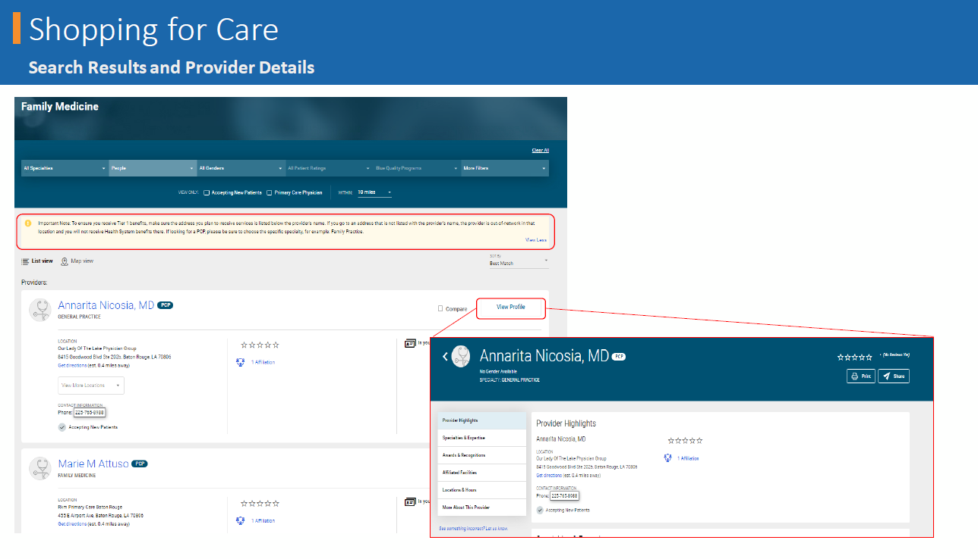
Search Results and Provider Details
Once you find a provider that interests you, click View Profile to learn more about them.
Important Reminder: Before receiving care, team members should confirm the location of where services are received and that the location of the provider is in network, as providers may have multiple affiliations, not all of which may be in our network. The best way to ensure this is to make sure you are receiving care from the provider in the location that matches the address listed on the Shopping for Care Tool.
There is no out-of-network coverage under the EPO Plan
unless otherwise required by law.

Slide 7
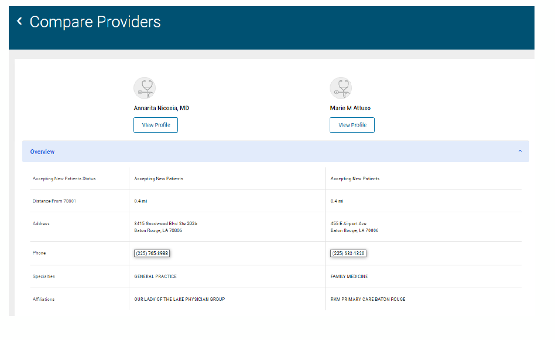
Provider Comparison Tool
Compare two providers that interest you to see what could be the best fit for you.
www.myhealthtoolkitla.com/links/fmolhs

Slide 8
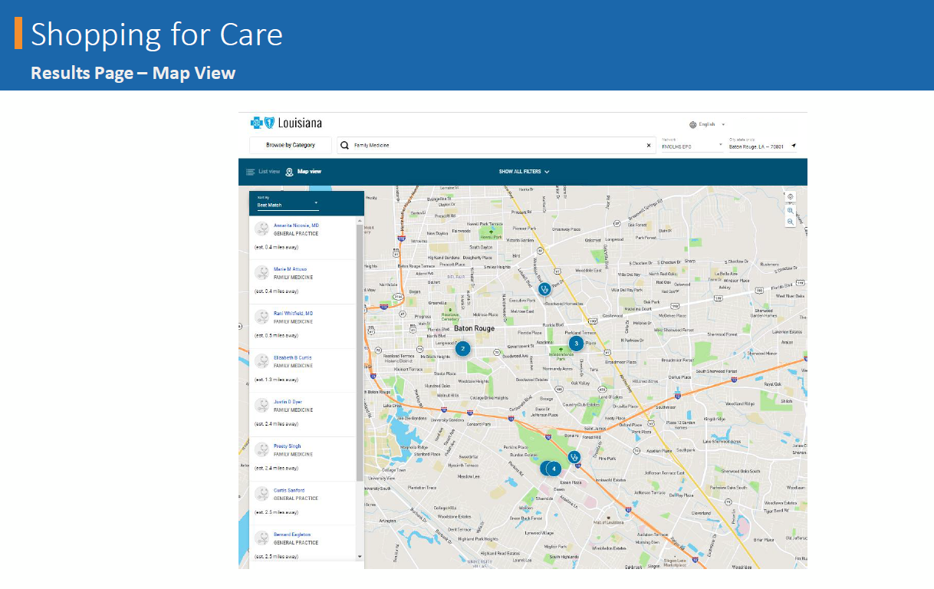
Results Page – Map View
Map out the location of where you will receive services.
myhealthtoolkitla.com/links/fmolhs

Slide 9
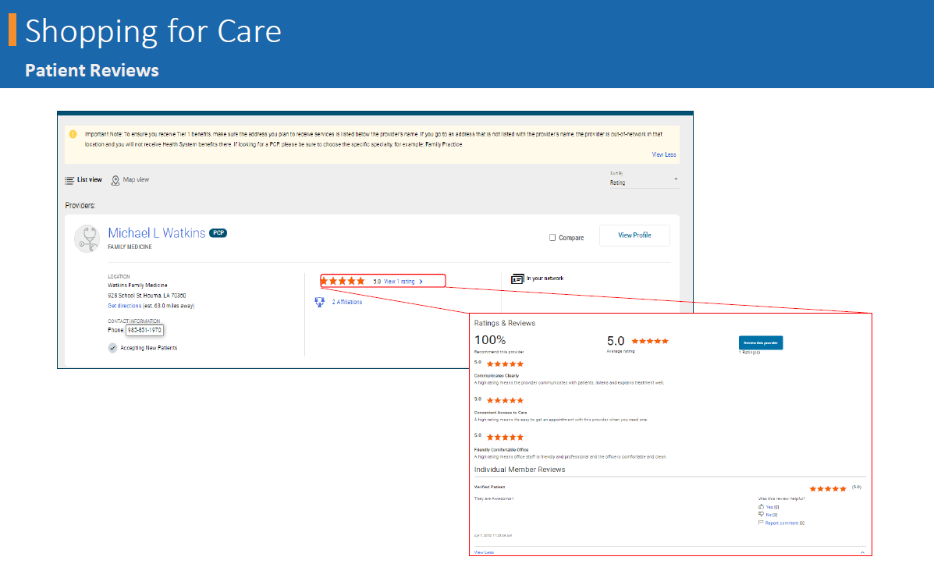
Patient Reviews
Checkout reviews from patients.
myhealthtoolkitla.com/links/fmolhs

Slide 10
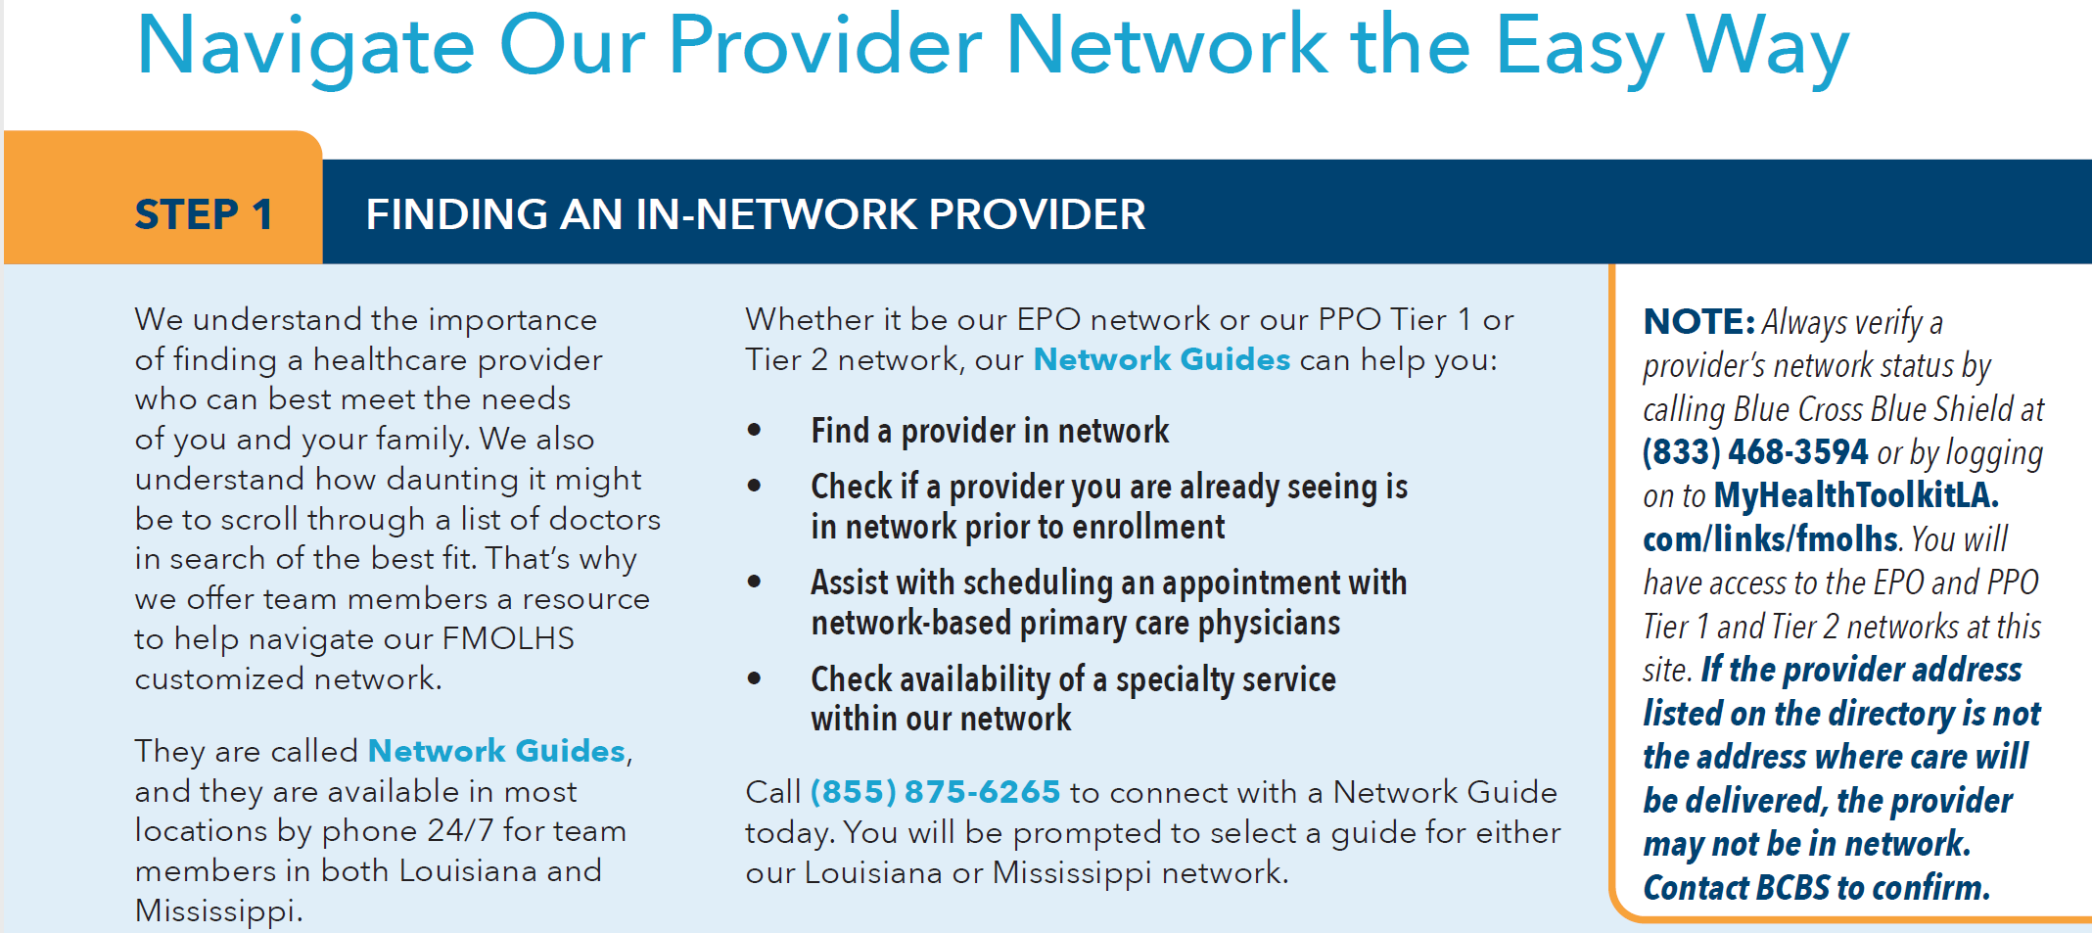
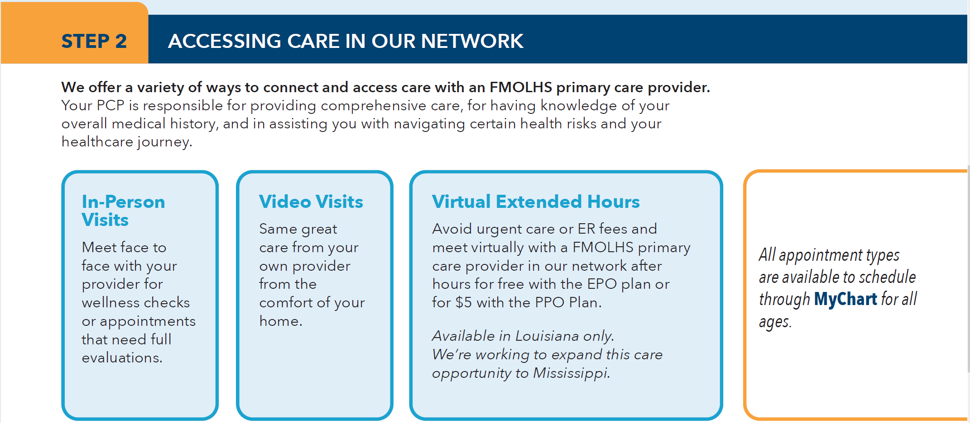
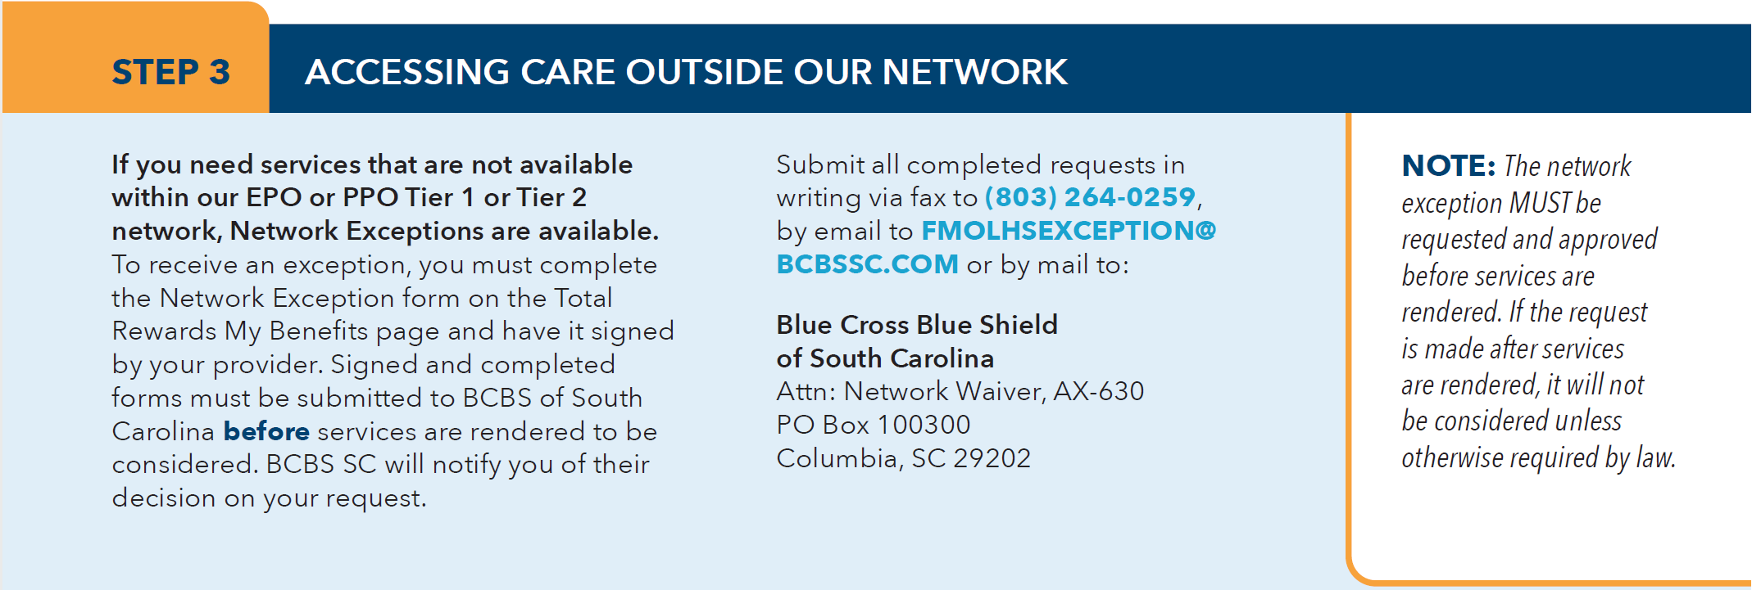
My Health – Provider Network
Always verify a provider’s network status by calling Blue Cross Blue Shield or by logging on to MyHealthToolkitLA.com/links/fmolhs.

Slide 11
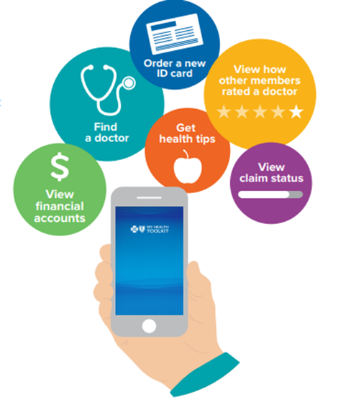
My Health Toolkit – On the Go
As a BCBSLA member, you can access your benefit and claim information any time using your mobile device
Be Healthy. Be Happy.
Register for My Health Toolkit to help you get started. You will have
anywhere, anytime access to your benefits information, insurance cards,
claims and covered local providers.
Download the My Health Toolkit mobile app. It’s free at:
MyHealthToolkitLA.com/links/FMOLHS.
Get Started Today
Why wait? It’s easy to sign up. In just a few clicks, you will have everything
you need at your fingertips.
1. Go to www.MyHealthToolkitLA.com and select Register Now.
2. Enter the number on your membership card and your date of birth. If
you don’t have your membership card, you can enter your social security
number.
3. Choose a username and password.
4. Enter your email address and choose to go paperless, if you would like.
myhealthtoolkitla.com/links/fmolhs

Slide 12

Where to Go with Questions
Need Help Navigating or Accessing the Find Care Tool?
Contact BCBS Customer Service at (833) 468-3594 for assistance.
Have questions about our FMOLHS benefits?
Contact askHR at (833) 482-7547 or at askHR@fmolhs.org for assistance.
myhealthtoolkitla.com/links/fmolhs

